Slide 1

AI-Powered Chess Video Analyzer
From Video to Voice: Detecting Chess Moves and Generating Funny Commentary with AI
By: Likhita Yerra

Slide 2

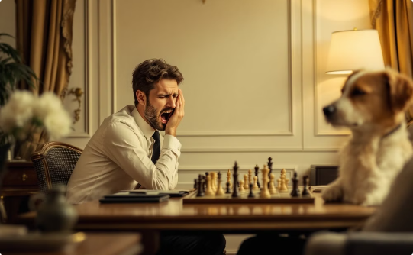

The Chess Viewing Challenge
Difficult to Follow
Lack of Engagement
Learning Barrier
Chess videos can be hard to track, especially for beginners unfamiliar with notation and strategy.
Traditional chess commentary often lacks excitement and accessibility for casual viewers.
Without clear move tracking and explanations, learning from videos becomes frustrating.
My solution combines Computer Vision to detect moves with Generative AI to create engaging, humorous commentary that makes chess accessible to everyone.

Slide 3

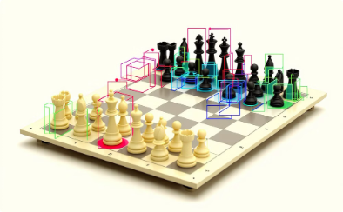
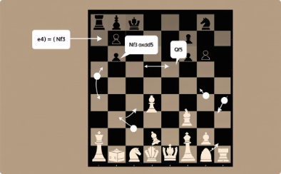
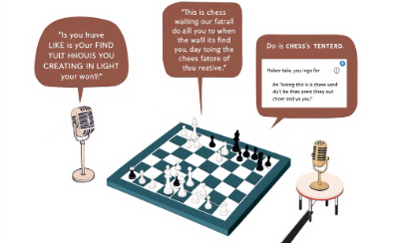
How My System Works
1. Video Input
2. AI Detection
3. Move Translation
4. Commentary Generation
Chess videos feed into the system for real-time processing.
YOLOv8 model tracks pieces and identifies board positions accurately.
Visual data converts into standard chess notation like "e4" or "Nf3".
GPT-4 creates witty commentary that text-to-speech brings to life.

Slide 4
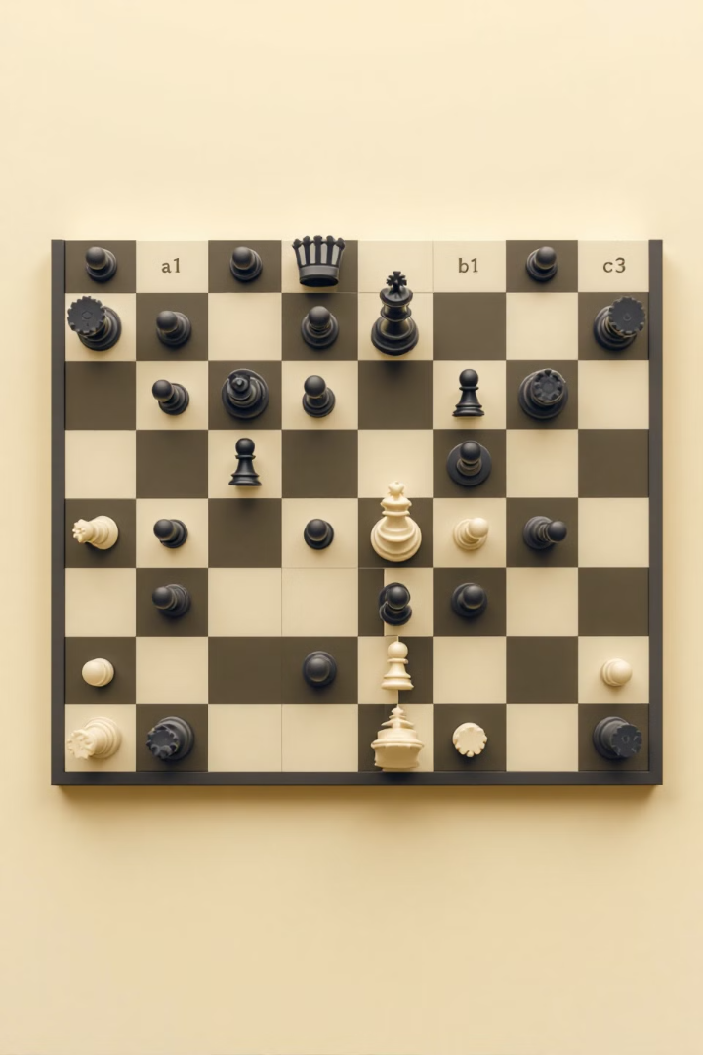
The Dataset I Used
Roboflow Collection
Thousands of labeled chessboard images from diverse environments. The variety ensures robust recognition across different viewing contexts.
Comprehensive Variety
Dataset includes different board styles, camera angles, and lighting conditions. This diversity makes the AI adaptable to real-world videos.
Piece Classification
Trained to recognize 12 distinct chess pieces (6 white, 6 black). Each piece has unique movement patterns the AI must understand.
Strategic Labeling
Custom annotation scheme optimized for piece position tracking. Enables the AI to follow games even with partial board visibility.

Slide 5
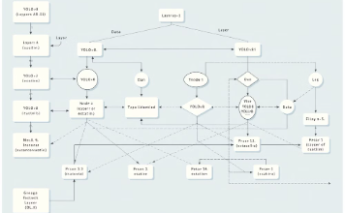

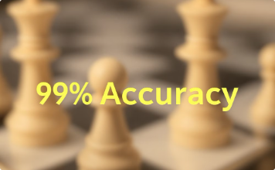
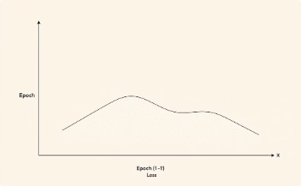
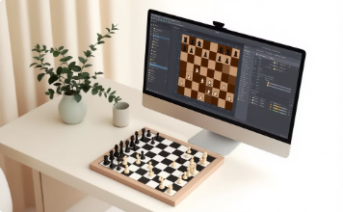
Training the AI Model
YOLOv8 Architecture
GPU Acceleration
Exceptional Accuracy
Efficient Convergence
Selected for its superior speed and accuracy in real-time object detection tasks.
Leveraged Google Colab's Tesla T4 GPU infrastructure to optimize training performance.
Achieved over 99% precision in chess piece recognition across various board scenarios.
Model reached optimal performance after just 11 training epochs.
Video Readiness
The trained model seamlessly processes live chess footage with minimal latency.

Slide 6
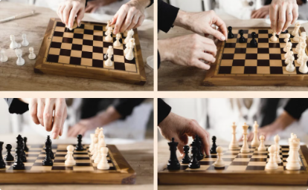
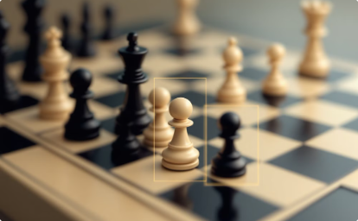
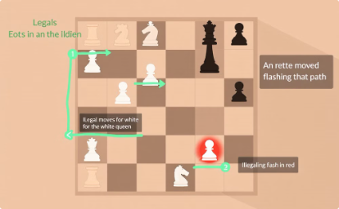
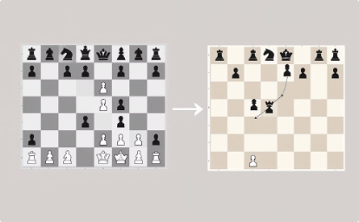
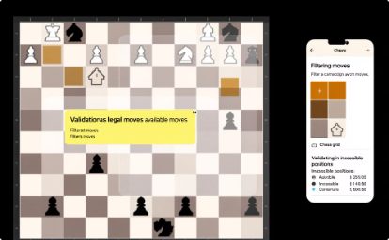
Detecting Moves in a Video
Frame Extraction
Piece Recognition
Board Mapping
Change Detection
Videos are broken down into sequential frames for analysis.
YOLOv8 model identifies each piece with 99% accuracy.
Each piece gets coordinates like "e4" on a virtual grid.
Frame-by-frame comparison reveals piece movements automatically.
Chess Logic Validation
Rule-based filtering eliminates impossible moves for accuracy.

Slide 7
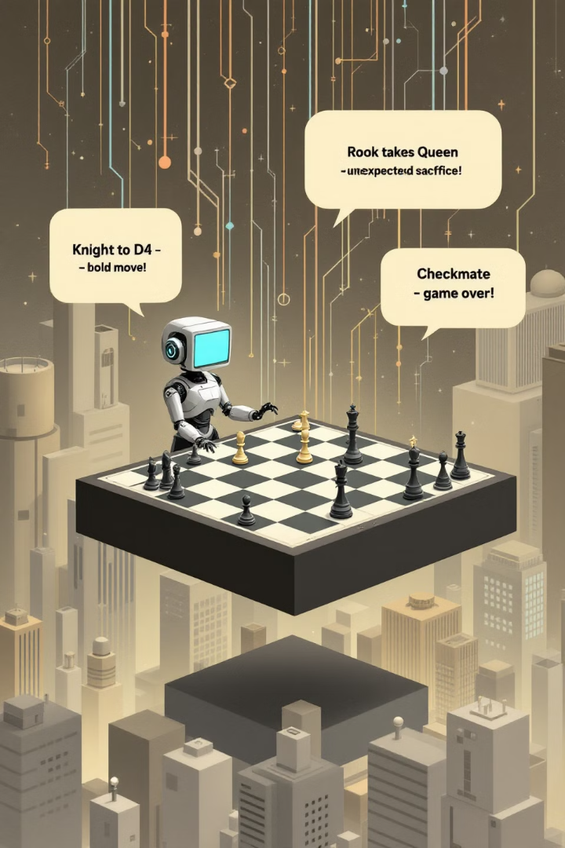
Making the Game Fun with GPT-4
Once moves are detected, GPT-4 transforms dry chess notation into engaging commentary.
Witty Observations
Strategic Insights
"That pawn to e4 is braver than a knight in shining armor!"
AI explains complex positions in accessible, entertaining language.
Personality Injection
Text-to-speech brings commentary to life with natural intonation.

Slide 8

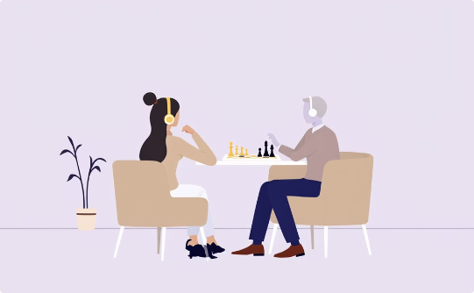
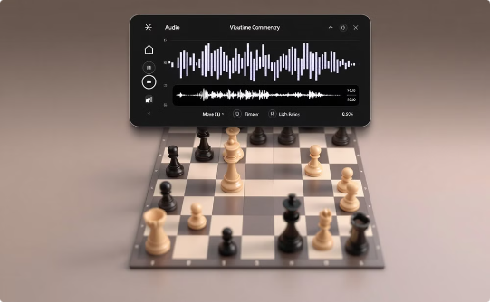
Turning Text Into Voice
Text-to-Speech Technology
Enhanced Viewing Experience
Real-Time Commentary
Google Text-to-Speech transforms GPT-4's witty chess commentary into lifelike audio with natural-sounding narration.
Users enjoy professional-quality commentary that follows each move in real-time, making chess videos accessible and entertaining for players of all levels.
The system delivers commentary that enhances viewing experiences without distracting from gameplay.

Slide 9
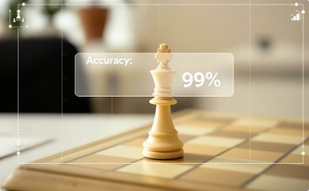
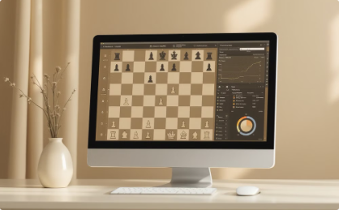
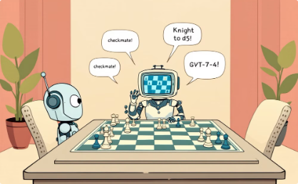
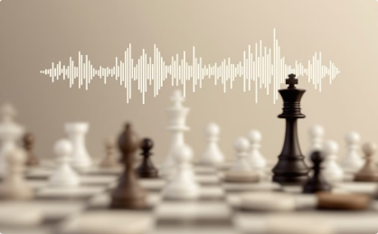
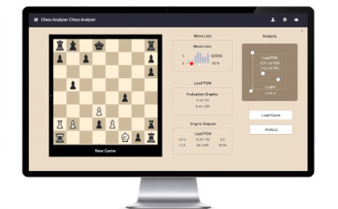
What I Achieved
Detection Excellence
Real-Game Processing
Engaging Commentary
Audio Narration
Achieved 99% accuracy in chess piece recognition across diverse board scenarios.
Successfully converted complex moves from actual games like Queen's Gambit.
Integrated GPT-4 to transform chess notation into witty, informative narration.
Implemented text-to-speech technology for natural-sounding chess commentary.
Complete Solution
Delivered a fully functional web application with intuitive user interface.

Slide 10

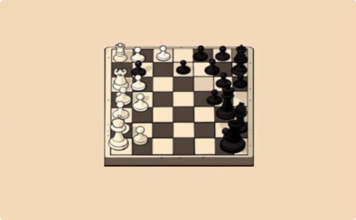


What Could Be Better?
Video Format Limitations
Viewing Angle Sensitivity
Lighting Challenges
Real-Time Processing
Low light or inconsistent illumination can confuse the piece recognition algorithm.
Some camera angles and video compression formats reduce detection accuracy below optimal levels.
The system performs best with top-down perspectives. Side angles create occlusion problems.
Current offline processing needs optimization for live streaming capabilities and broader deployment.

Slide 11
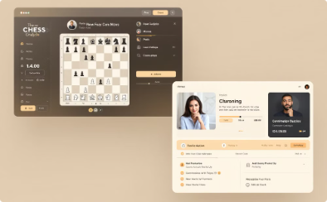
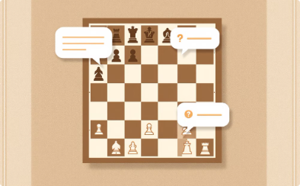
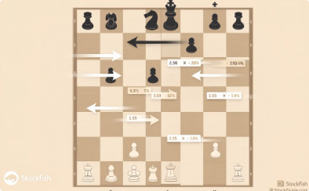
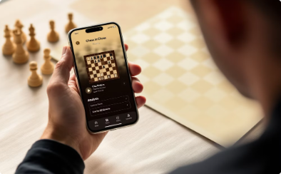
What's Next?
Real-Time Streaming Analysis
Interactive Q&A System
Stockfish Integration
Mobile Application
Incorporate professional chess engine analysis to offer powerful coaching feedback and alternative move suggestions.
Package the complete system into a user-friendly mobile app for chess enthusiasts, students, and content creators.
Process and analyze chess games as they happen live, providing instant commentary and insights.
Allow viewers to ask questions about positions, strategies, or specific moves during gameplay.
These enhancements will transform chess viewing from passive observation into an engaging, educational experience accessible anywhere.

